Slide 1
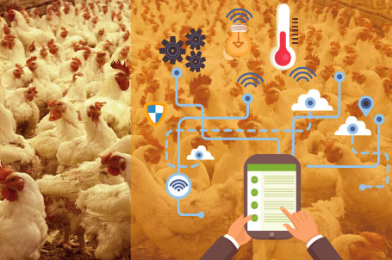
IoT Enabled Smart Poultry Farm
MEMBERS:
B.BHAVANI
D.N.AISWARYA
K.MANISHA

Slide 2
Contents
Introduction
Poultry Market In India
Problems in poultry
Use of IoT in poultry farm
Components used
Working process
Conclusion

Slide 3
Introduction
The Internet of things (IoT) is the extension of Internet connectivity into physical devices and everyday objects. Embedded with electronics, Internet connectivity, and other forms of hardware (such as sensors), these devices can communicate and interact with others over the Internet, and they can be remotely monitored and controlled.
IoT is leading the digital revolution for industries.
Internet of things has evolved due to convergence of multiple technologies, real-time analytics, machine learning, commodity sensors, and embedded systems.

Slide 4
Poultry Market In India
Indian poultry industry is one of the fastest growing segments in agricultural sector today.
The production of eggs and broilers has been rising at a rate of 8 to 10% per annum.
Today India is world’s fifth largest egg producer and the eighteenth largest producer of broilers.
Poultry gives rich natural excrement and is an essential wellspring of pay and job to a huge number of farmers and different persons occupied with united exercises in the poultry business.

Slide 5
Problems in poultry
The health of chicken depends on the environment in the poultry farm. If the environmental condition is not suitable then there may be problem with growth of the chicken and in their health issues.
Weather condition is the major problem in the poultry farming.
Humidity ,temperature ,lighting and ventilation are the most important variables for the proper performance of poultry farms.
Food and water supply to the hens and wastage of water.

Slide 6
Use of IoT in poultry Farm
IoT proposes the new model by using advanced modern technology to make traditional chicken farming smarter. Smart farm gives the environmental parameter statistics like temperature, humidity, smoke, weather condition etc.
Poultry farm using IoT are design in such way that, environmental conditions can be altered by providing facilities like ventilation, cooling and lightening on rough, wall and floor.
We can remotely monitor environmental parameters in the poultry farm and even water level in the tank.

Slide 7
Components used
Hardware components:
NodeMCU
DHT sensor
Ultrasonic sensor
MQ2 sensor (Gas sensor)
Servomotor
OLED (to display)
software component:
Arduino IDE
MIT App Inventor2

Slide 8
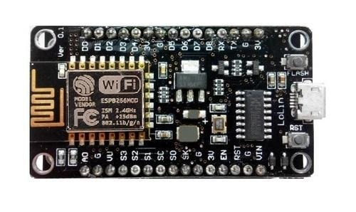
Hardware Components:
NodeMCU
NodeMCU is an open source IoT platform. It includes firmware
which runs on the ESP8266Wi- Fi SoC from Espressif
Systems, and hardware which is based on the
ESP-12 module.
The term "NodeMCU" by default refers to the firmware
rather than the development kits. It is the single-board
microcontroller.

Slide 9
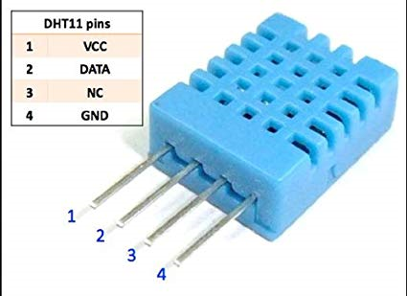
DHT Sensor
This DHT11 Temperature and Humidity Sensor features a
calibrated digital signal output with the temperature
and humidity sensor capability.
It is integrated with a high-performance 8-bit microcontroller. Its technology ensures the high reliability and excellent long-term stability.
This sensor includes a resistive element and a sensor for wet NTC temperature measuring devices.

Slide 10
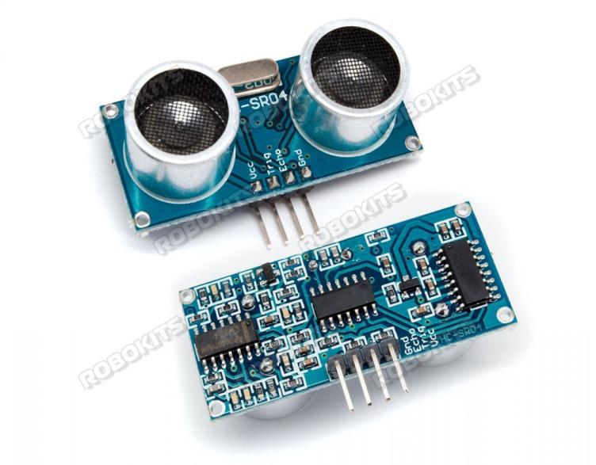
Ultrasonic Sensor:
Ultrasonic transducers or ultrasonic sensors are a type of acoustic sensor divided into three broad categories: transmitters, receivers and transceivers.
Transmitters convert electrical signals into ultrasound, receivers convert ultrasound into electrical signals and transceivers can both transmit and receive ultrasound.
In a similar way to radar and sonar, ultrasonic transducers are used in systems which evaluate targets by interpreting the reflected signals.

Slide 11
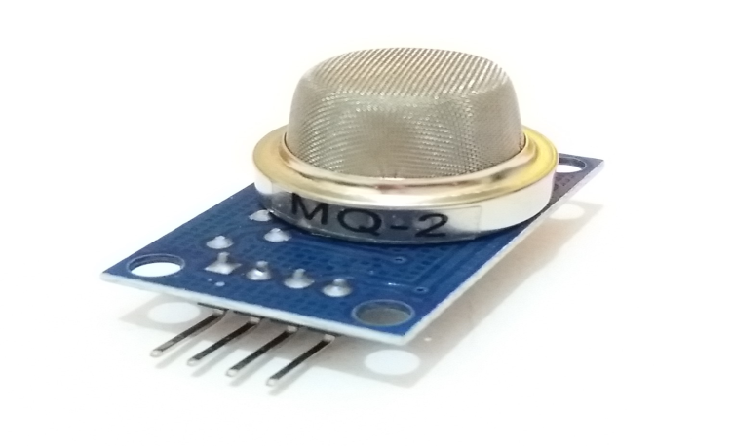
MQ2 Sensor(Gas sensor):
The Grove - Gas Sensor(MQ2) module is useful for
gas leakage detection (home and industry).
It is suitable for detecting H2, LPG, CH4, CO, Alcohol,
Smoke or Propane. Due to its high sensitivity and
fast response time, measurement can be taken as soon as possible.
The sensitivity of the sensor can be adjusted by potentiometer.

Slide 12
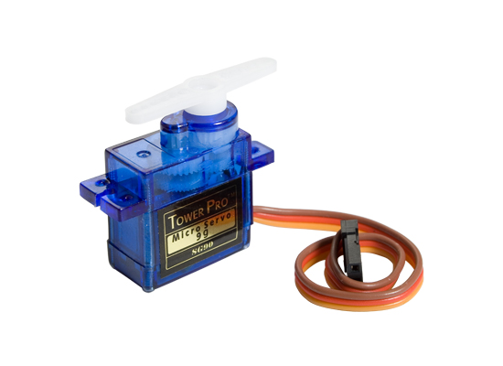
Servomotor
A servomotor is a rotary actuator or linear actuator that
allows for precise control of angular or linear position,
velocity and acceleration.
It consists of a suitable motor coupled to a sensor for
position feedback.
It also requires a relatively sophisticated controller,
often a dedicated module designed specifically for use with servomotors.

Slide 13
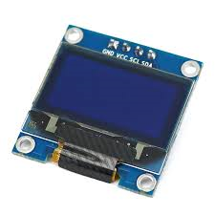
OLED:
An organic light-emitting diode (OLED) is a light-emitting diode (LED) in which the emissive electroluminescent layer is a film of organic compound that emits light in response to an electric current.
This organic layer is situated between two electrodes; typically, at least one of these electrodes is transparent.
OLEDs are used to create digital displays in devices such as television screens, computer monitors, portable systems such as smart phones , handheld game consoles and PDAs.

Slide 14
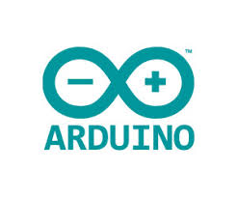
Software Components:
Arduino IDE:
The Arduino integrated development environment (IDE)
is a cross-platform application (for Windows, macOS,
Linux) that is written in the programming language Java.
It is used to write and upload programs to Arduino
compatible boards, but also, with the help of 3rd party
cores, other vendor development boards.

Slide 15

MIT App inventor 2
App Inventor for Android is an open-source web application originally provided by Google and now maintained by
the Massachusetts Institute of Technology(MIT), which allows newcomers to computer programming to create software applications for the Android operating system (OS).
It uses a graphical interface very similar to Scratch and the
StarLogo TNG user interface, which allows users to drag-and-drop visual objects to create an application that can run on Android devices.

Slide 16
Working PROCESS
Firstly we will use gas sensor (MQ2 sensor) for detecting the presence of harming gases and sends out the notification .
DHT sensor is used to check the temperature in the poultry and sends the message whether the temperature is high or low.
Ultrasonic sensor is used to find out the water level in the tank and send the notification whether the water is full and off the motor or the water is empty turn on the motor.
Servomotor is also used for the same water purpose itself and fills the tank periodically.

Slide 17
Conclusion
Monitoring environmental parameters in a real time industry are crucial , but this can be done using IoT.
It helps the farmers real time controlled and monitoring environmental aware context parameters.
This smart system can effectively control the farm from any location and reduces the cost time and man power.
This will improve productivity and quality of chickens in poultry farming. In the future advanced IOT based technologies should be use for monitoring and controlling health related parameters of chicken to improve quality and productivity of chickens.

Slide 18
THANK YOU

